Slide 1
SMART POINTERS - PART 1
(std::unique_ptr)

Slide 2
Raw Pointer
int main()
{
int n = 2;
int * p = &n;
int * q = new int(3);
delete q;
}
Heap
3
q
Stack
0x60
0x56
p
2
n
A pointer is a mechanism to indirectly reference the data.

Slide 3
POINTER PITFALLS

Slide 4
Pointer Pitfalls
class Entity
{
public :
Entity(int num) : x(num) { }
void print() { std::cout << x << "\n"; }
int getX() { return x; }
private :
int x;
};
void foo() {
Entity * e = new Entity(3);
if (Validation(e)) {
return;
}
e->print();
// .......
delete e;
// .......
e->print();
}
// memory leak

Slide 5
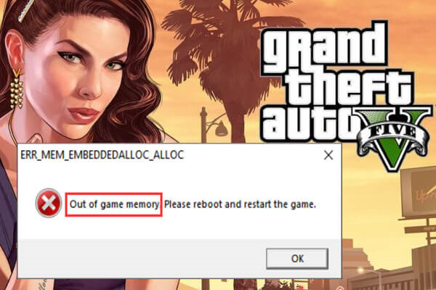

Slide 6
Pointer Pitfalls
class Entity
{
public :
Entity(int num) : x(num) { }
void print() { std::cout << x << "\n"; }
int getX() { return x; }
private :
int x;
};
void foo() {
Entity * e = new Entity(3);
if (!Validation(e)) {
return;
}
e->print();
// .......
delete e;
// .......
e->print();
}
// memory leak
// dangling pointer

Slide 7
Pointer Pitfalls
// pointer cannot differentiate between single object or array of objects
int * p = new int(5) // single object
int * p = new int[5] // array of 5 int
// Different ways to delete memory
delete p; // single object
delete [] p; // array of 5 int
// Ownership issue
Entity * e = new Entity(3);
Entity * f = e;
delete e;
delete f;

Slide 8
Summary
Memory Leak
Dangling Pointers
Ownership issues
Dynamic Memory Management

Slide 9
What’s wrong ?
void foo() {
Entity * e = new Entity(3);
if (!Validation(e))
{
delete e;
return;
}
e->print();
delete e;
}

Slide 10
Scoped LifeTime
Prefer Scoped Lifetime by default (Local and Member Objects)
-- Herb Sutter, “Leak Freedom in c++ .. By default”, 2016
void foo() {
Entity * e = new Entity(3);
if (!Validation(e))
{
delete e;
return;
}
e->print();
delete e;
}
void foo() {
Entity e(3);
if (!Validation(e))
{
return;
}
e.print();
}

Slide 11
SMART POINTERS

Slide 12
Smart Pointers
Ensure objects are destroyed in the
appropriate manner at the appropriate time
RAII

Slide 13
Smart Pointers
std::auto_ptr (deprecated in c++11, removed in c++17)
std::unique_ptr
Exclusive ownership
Lightweight pointer
Destroys the object when goes out of scope
std::shared_ptr
Shared ownership
Destroys the object when the last reference is released
std::weak_ptr
Breaks cyclic references

Slide 14
std::unique_ptr

Slide 15
std::unique_ptr
Heap
#include <memory>
{ std::unique_ptr<Entity> up1(new Entity(3));
}
Entity
3
Stack
up1
Unique pointer recognizes it points to single object, hence delete is used to free the memory

Slide 16
std::unique_ptr
up1->print()
(*up1).getX()
Use like pointers
-> and * operators availaable
if (up1)
if (up1 != nullptr)
if (up1.get() != nullptr)
Check for null-ness
up1 = nullptr
up1.reset()
frees up the memory and sets to nullptr

Slide 17
Enforcement of exclusive ownership
No copy constructor, No copy assignment operator(Compiler Error)
std::unique_ptr<Entity> up1(new Entity(3));
auto up2 = up1;
std::unique_ptr<Entity> up1; up1 = new Entity(3);

Slide 18
Transfer ownership of std::unique_ptr
std::unique_ptr is move-only type(non-copyable)
Heap
Entity
std::unique_ptr<Entity> up1(new Entity(3))
//auto up2 = up1; // won't compile
auto up2 = std::move(up1);
3
Stack
up1
up2

Slide 19
Transfer ownership of std::unique_ptr
std::vector<std::unique_ptr<Entity>> vectorOfEntity;
std::unique_ptr<Entity> up1(new Entity(3));
vectorOfEntity.push_back(up1); // Compile error
vectorOfEntity.push_back(new Entity(4)); // Compile error
vectorOfEntity.push_back(std::move(up1)); // transfer the ownership
vectorOfEntity.emplace_back(new Entity(4)); // create in-place object

Slide 20
Make smart pointer DUMB again!
Do not use raw pointers to initialize the unique_ptr
Heap
unique_ptr<Entity> up1(new Entity(3));
Entity
3
Entity *e = new Entity(3);
std::unique_ptr<Entity> up1(e);
std::unique_ptr<Entity> up2(e);
Stack
auto up1 = std::make_unique<Entity>(3);
up1
up2

Slide 21

std::unique_ptr for arrays
Heap
std::unique_ptr<int[]> up1(new int[10]);
OR auto arrayOfUniquePtrs = std::make_unique<int[]>(10);
// Array will be destroyed using delete[]
// indexing [] operator available
int[]
3
4
5
Stack
up1

Slide 22

Handling Non-Memory Resources
Resource is not supposed to be deleted
Dynamically allocated objects
FILE* fp = std::fopen(“dummy.txt”, “w”);
// Write something to file fclose(fp);
Custom functions provided by the library are to be used to create and destroy the object like Create() and Destory()
Memory

Slide 23
Custom deleters with std::unique_ptr
// Library Functions
Entity* Create(int num);
void Destroy(Entity* e);
struct StatelessFunctorDeleter {
void operator()(Entity * e) {
Destroy(e);
}
};
std::unique_ptr<Entity, StatelessFunctorDeleter> up(Create(3));
Heap
Entity
3
Stack
deleter
up
Notes:
https://godbolt.org/z/oodc4r

Slide 24
Custom deleters with std::unique_ptr
Cannot use std::make_unique with custom deleters
auto LambdaDeleter= [](Entity * e)
{
Destroy(e);
};
std::unique_ptr<Entity, decltype(LambdaDeleter)> up(Create(3), LamdaDeleter());
Notes:
https://godbolt.org/z/8o4Tj5

Slide 25
Memory footprint of std::unique_ptr
Entity * e | 8
unique_ptr<Entity> | 8
unique_ptr<Entity, StatelessFunctorDeleter> | 8
unique_ptr<Entity, LamdaDeleter> | 8
unique_ptr<Entity, void(*)(Entity*)> | 16
std::unique_ptr<Entity, std::function<void(Entity *)>> | 40
https://godbolt.org/z/3v9Ksd

Slide 26


